Slide 1
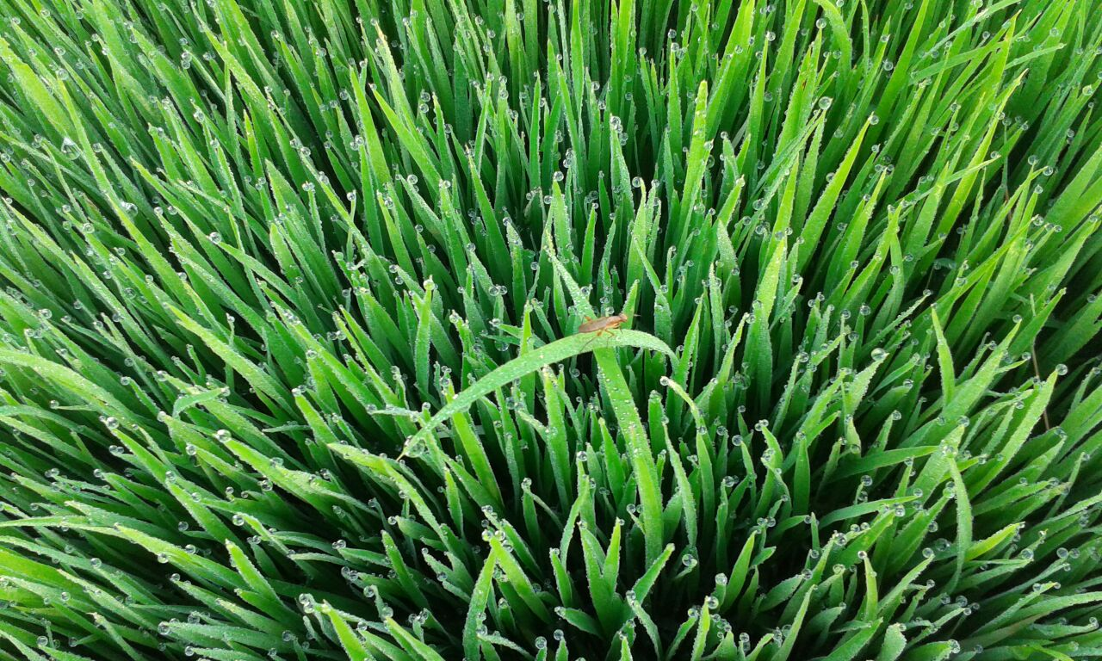
PEST CONTROL THROUGH
NATURAL ENEMIES
Resmi M.V, Agri. Officer, Krishibhavan, Vadakkenchery

Slide 2
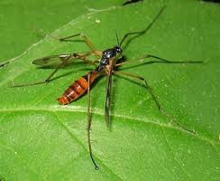
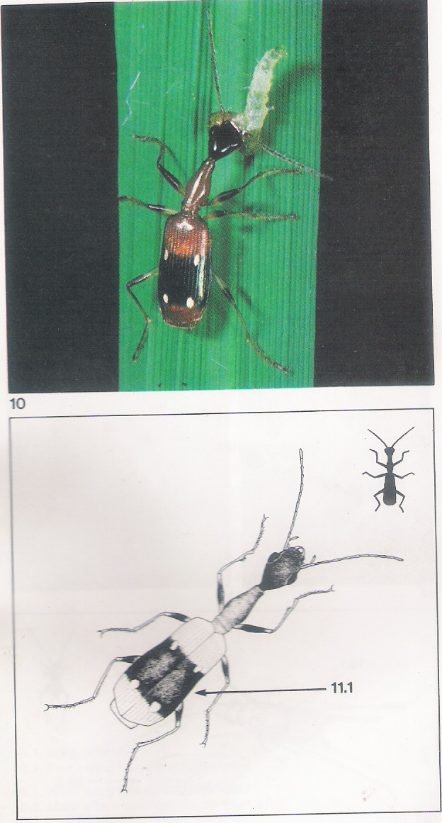
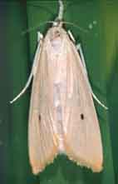
Agro Ecosystem Analysis in Rice
3 Types of insects in paddy fields
Neutrals in in paddy fields
Natural enemies in paddy fields
Insect pests in paddy fields

Slide 3
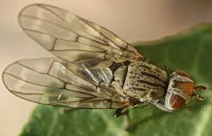
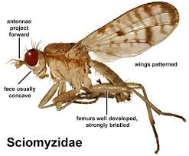
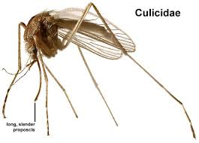
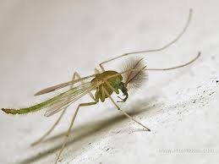
NEUTRALS IN PADDY FIELDS
Filter feeders – feeds on small plants
Detritivors – feeds on small animals
Otitidae
Chironomidae
Tanyderidae

Slide 4
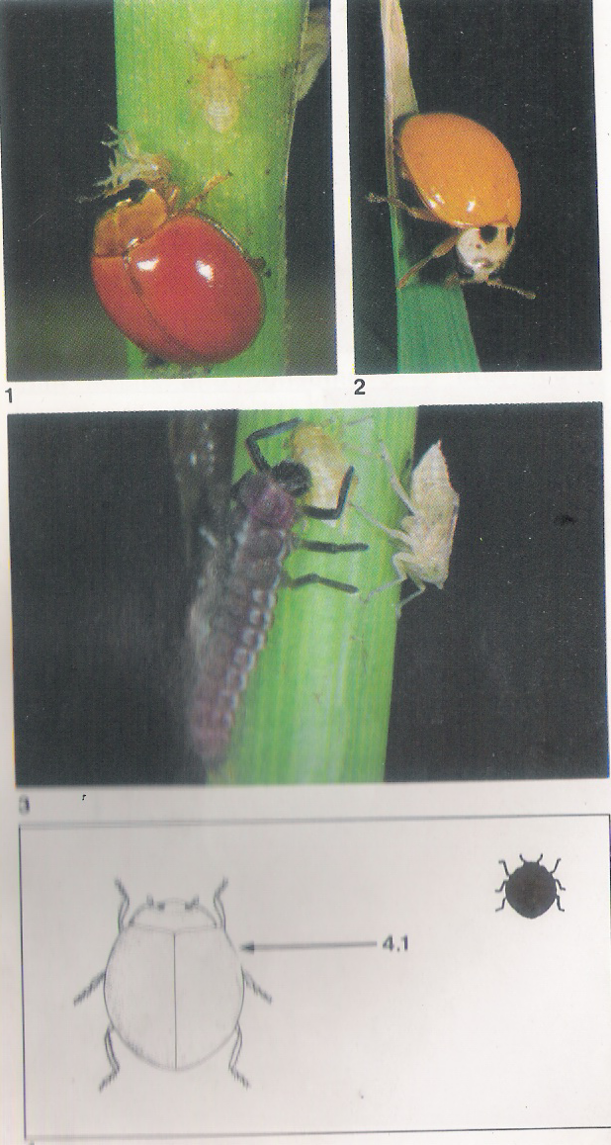
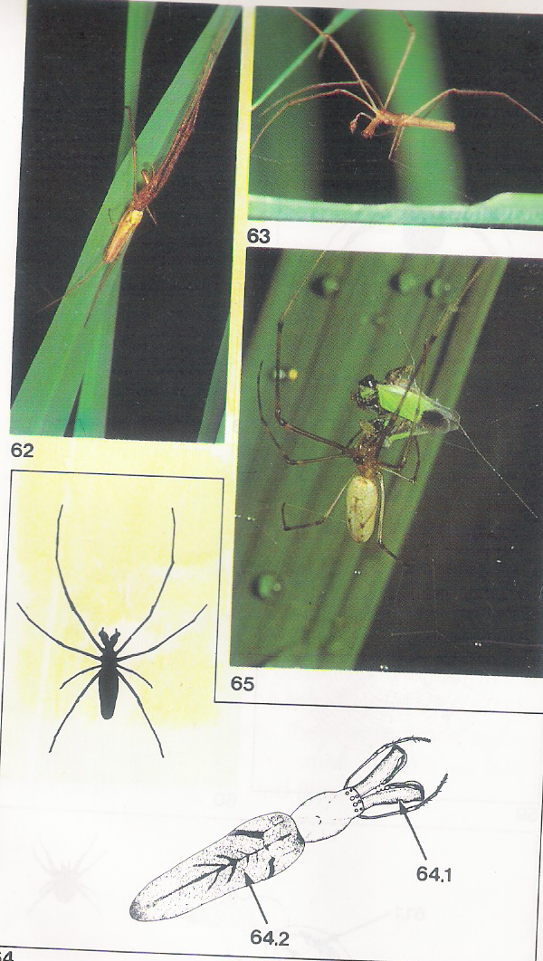
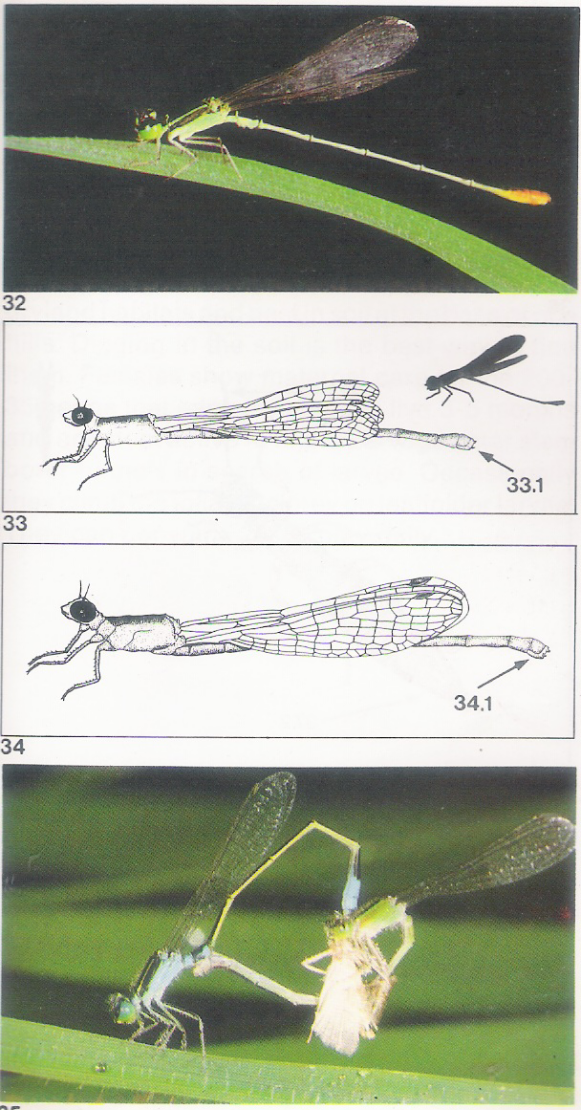
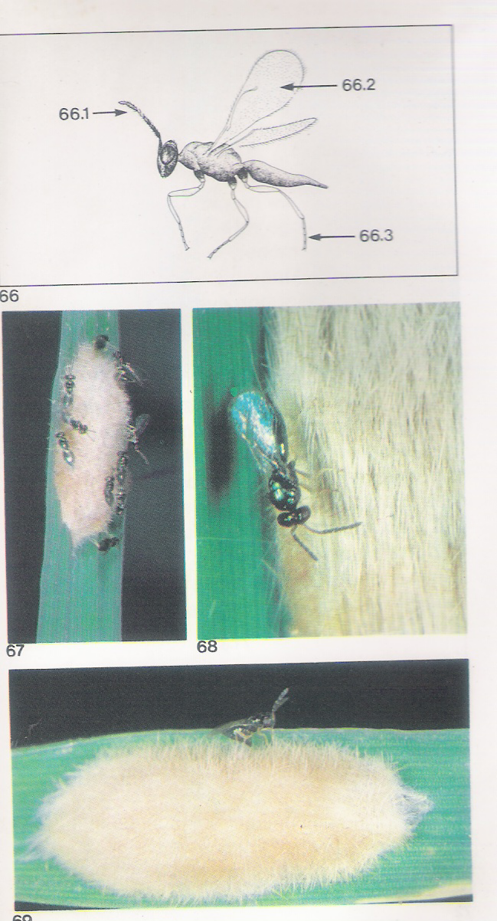
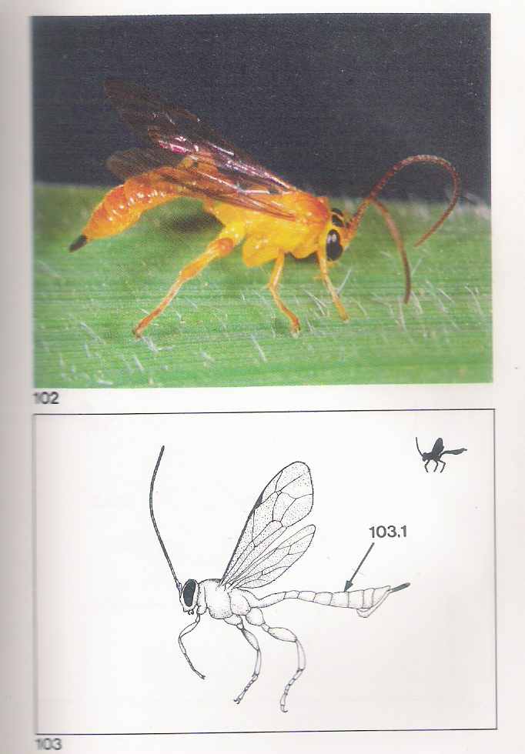
NATURAL ENEMIES IN PADDY FIELDS
Predators
Spiders
Damsel flies
Beetles
Crickets
Grass Hoppers
Bugs
Parasitoides
Egg parasitoides
Larval parasitoides
Pupal Parasitoides
Adult feeders

Slide 5
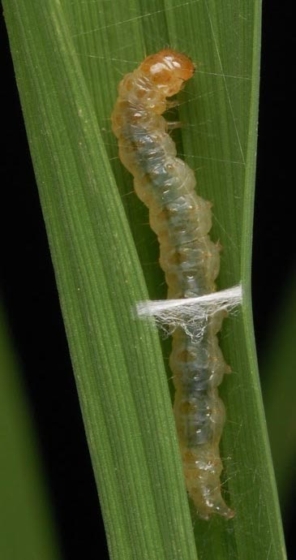
PESTS IN PADDY FIELDS
Leaf folder in Rice
Stem Borer in Rice
Gall midge in Rice
Thrips in Rice
Case worm in Rice
Blue beetle in Rice
Skipper in Rice

Slide 6
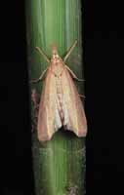
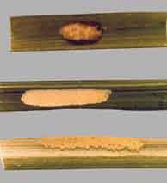
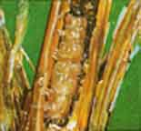
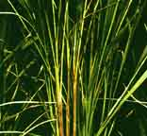
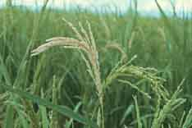
STEM BORER
Total life cycle: 6 weeks
Egg laying capacity – 150 nos.

Slide 7
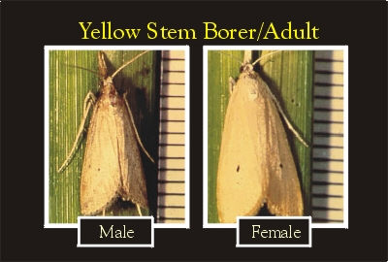
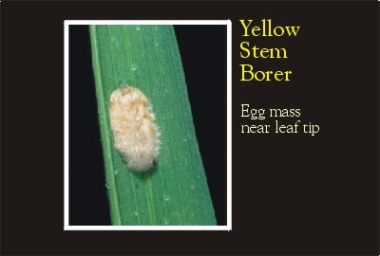
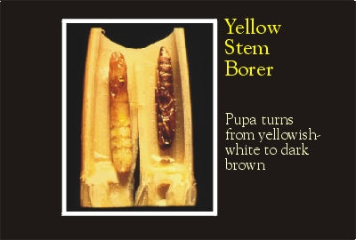
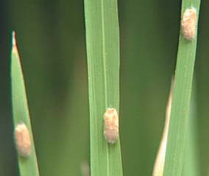
YELLOW STEM BORER IN RICE

Slide 8
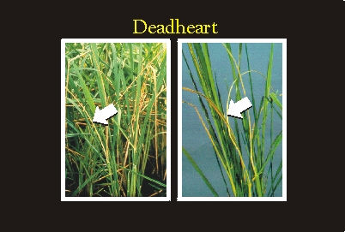
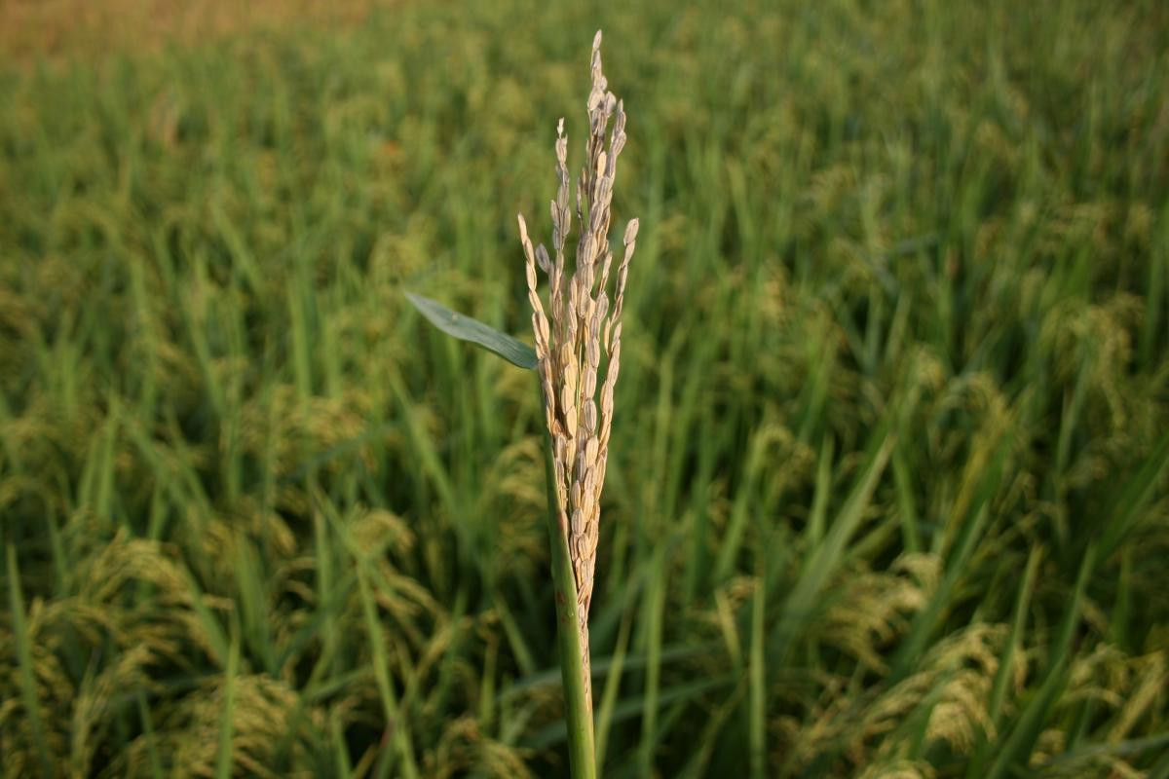
YELLOW STEM BORER ATTACK IN RICE

Slide 9
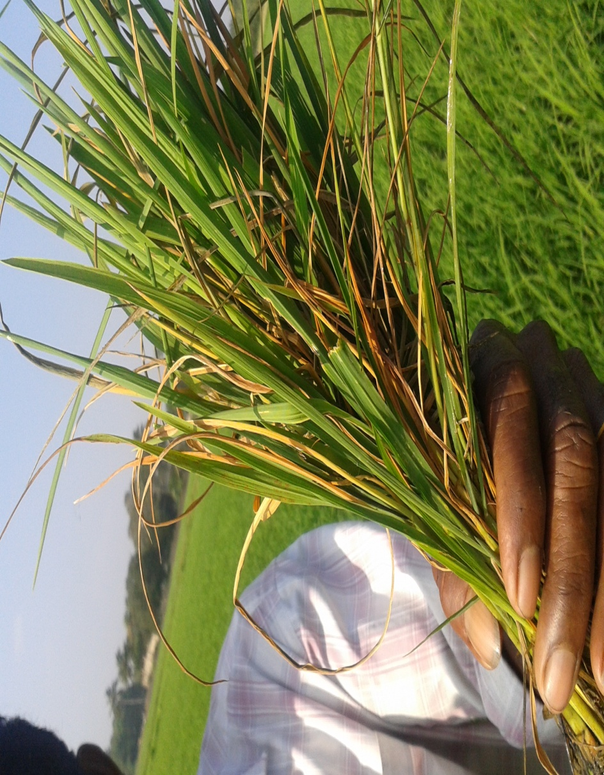
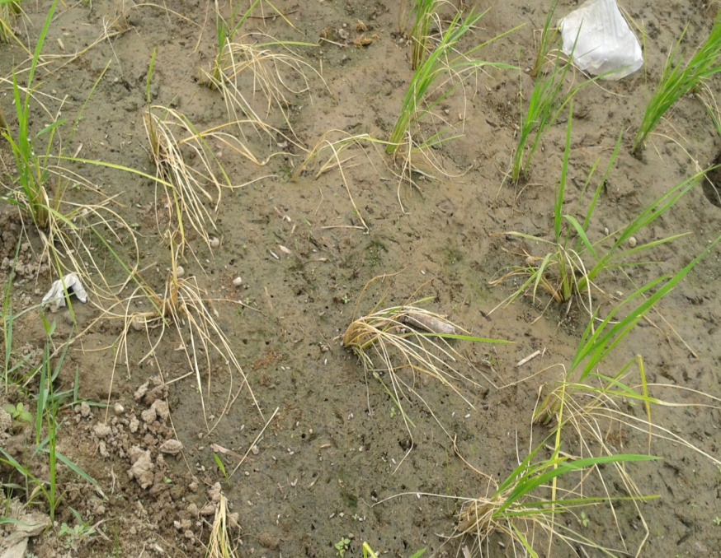
DEAD HEART DUE TO STEMBORER

Slide 10
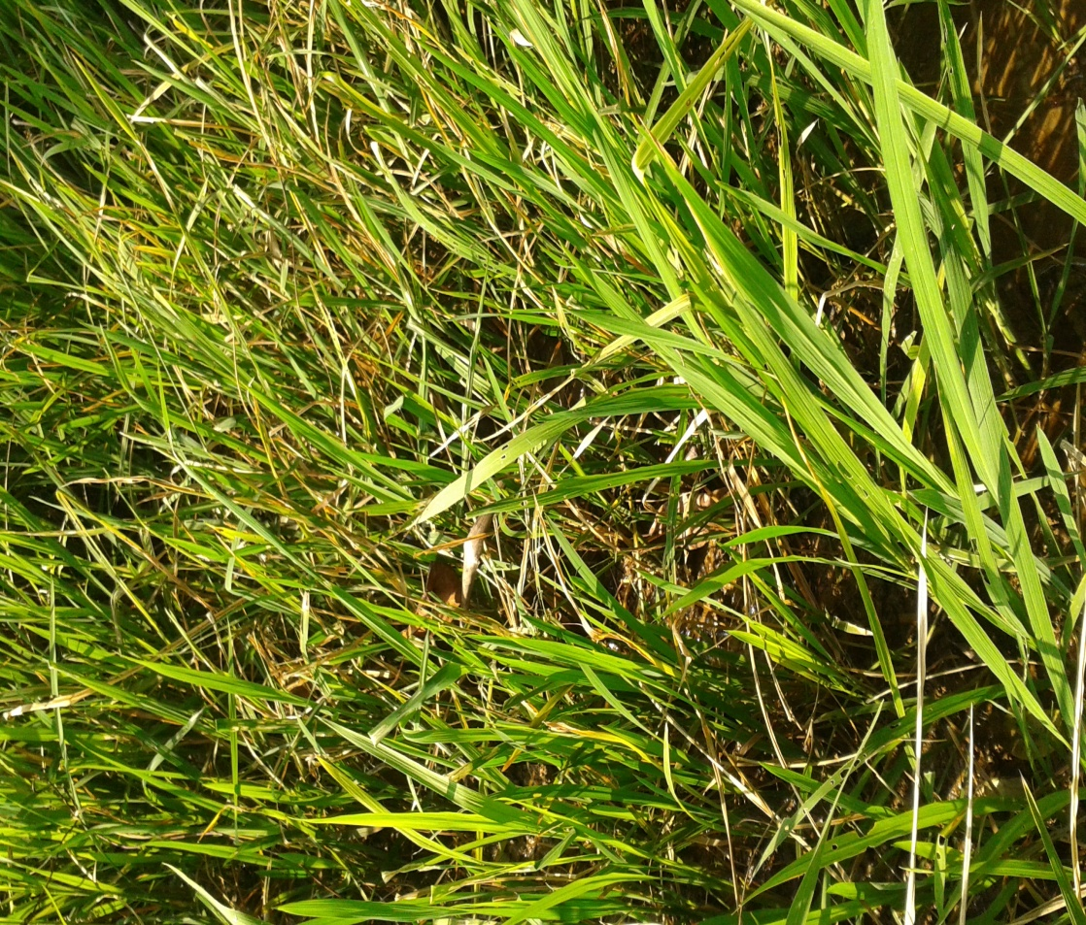
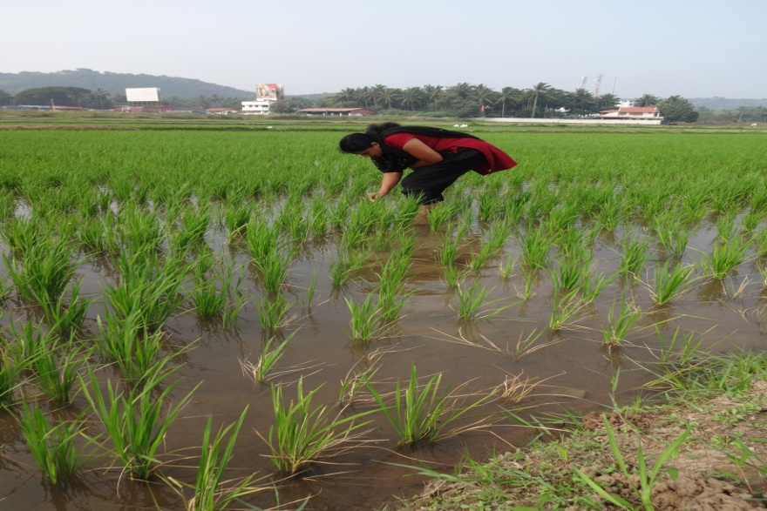
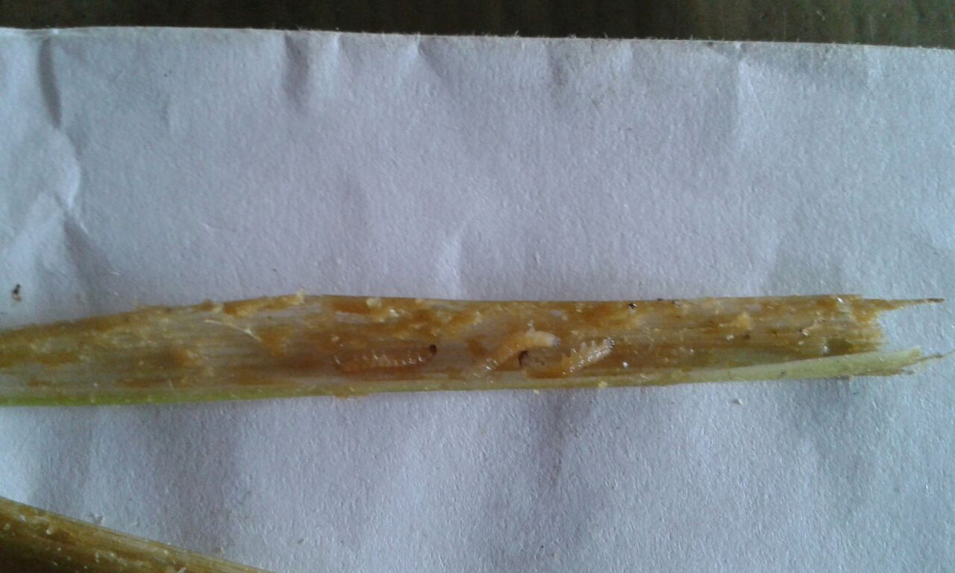
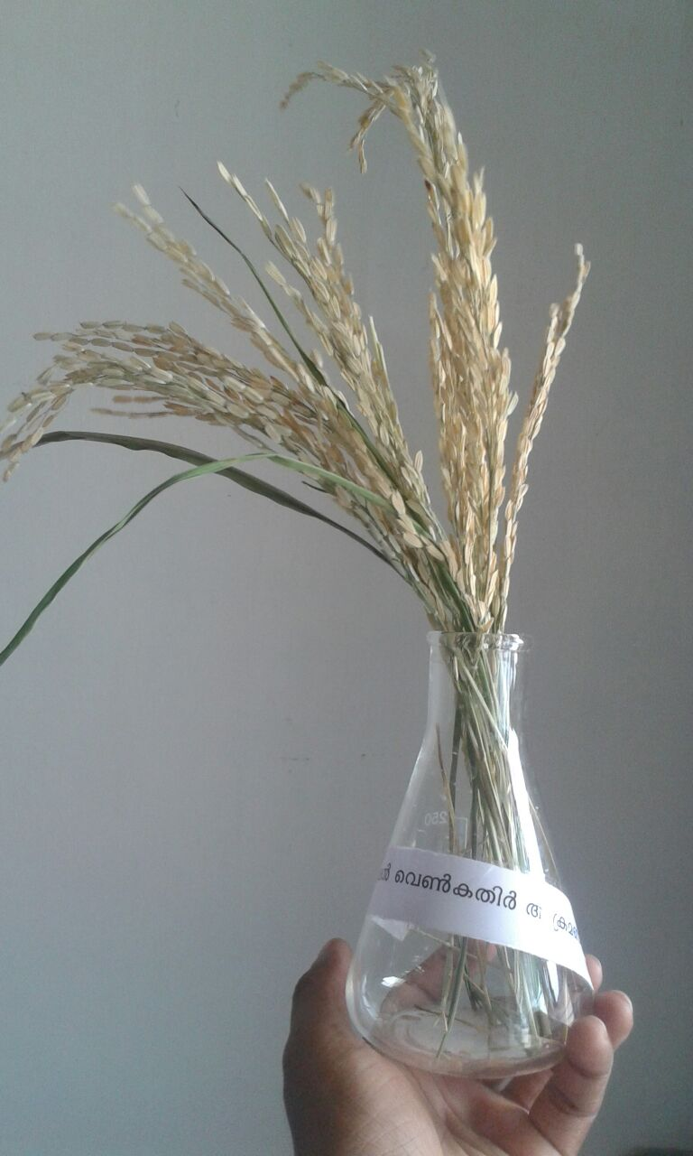
Stem Borer attack in paddy
Early Tillering stage
Mid tillering stage
Dead heart
White ear heads

Slide 11
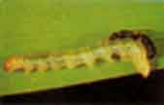
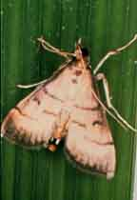
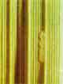
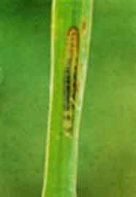
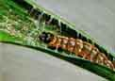
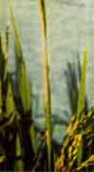
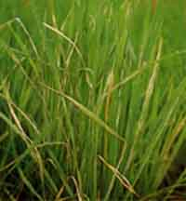
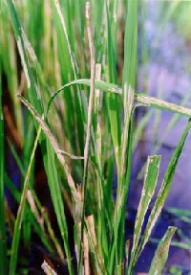
LEAF FOLDER
Total life cycle: 5 weeks
Egg laying capacity – 118 nos.

Slide 12
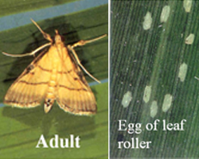
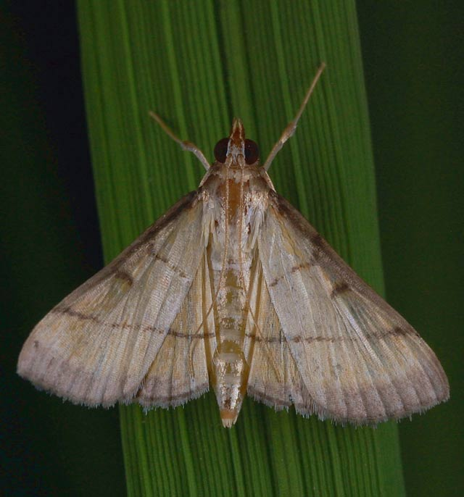
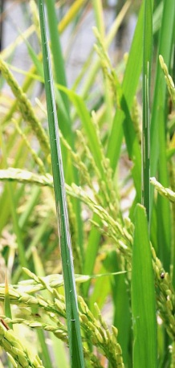
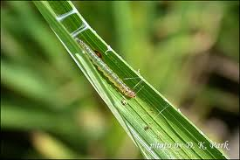
LEAF FOLDER IN RICE

Slide 13
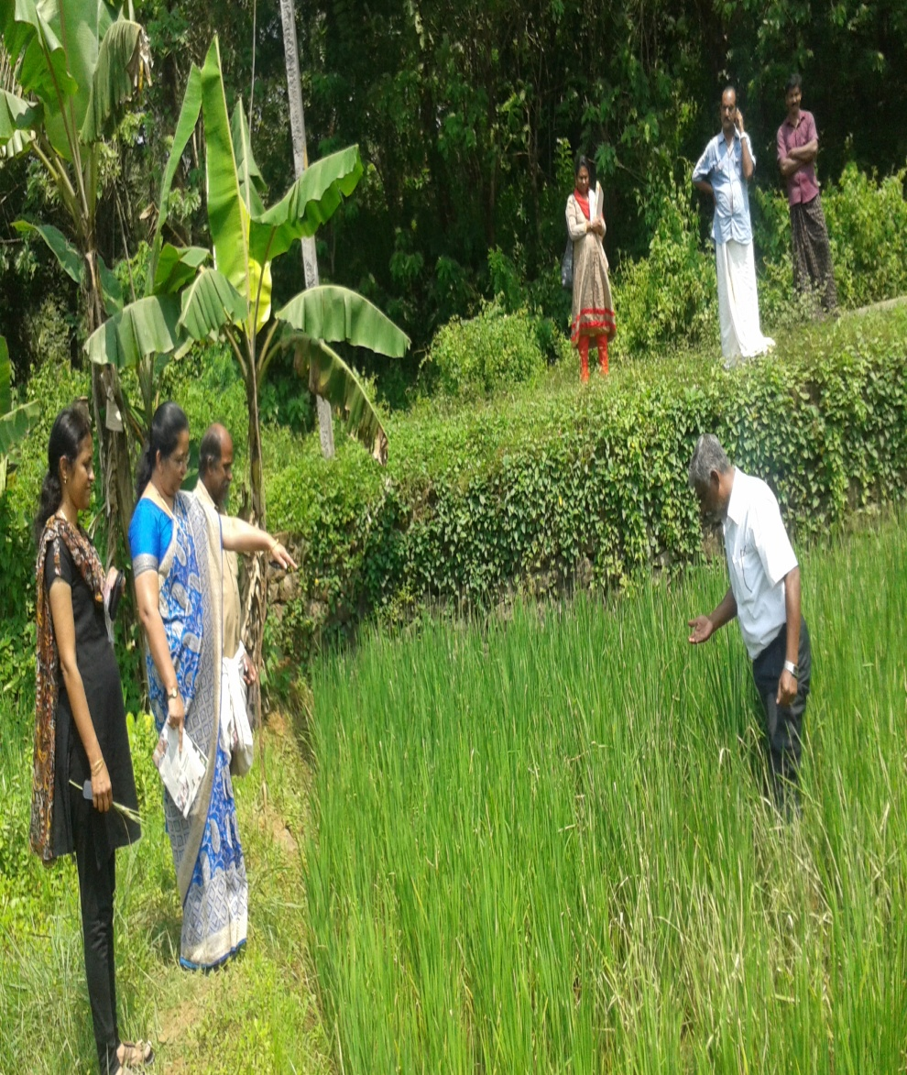
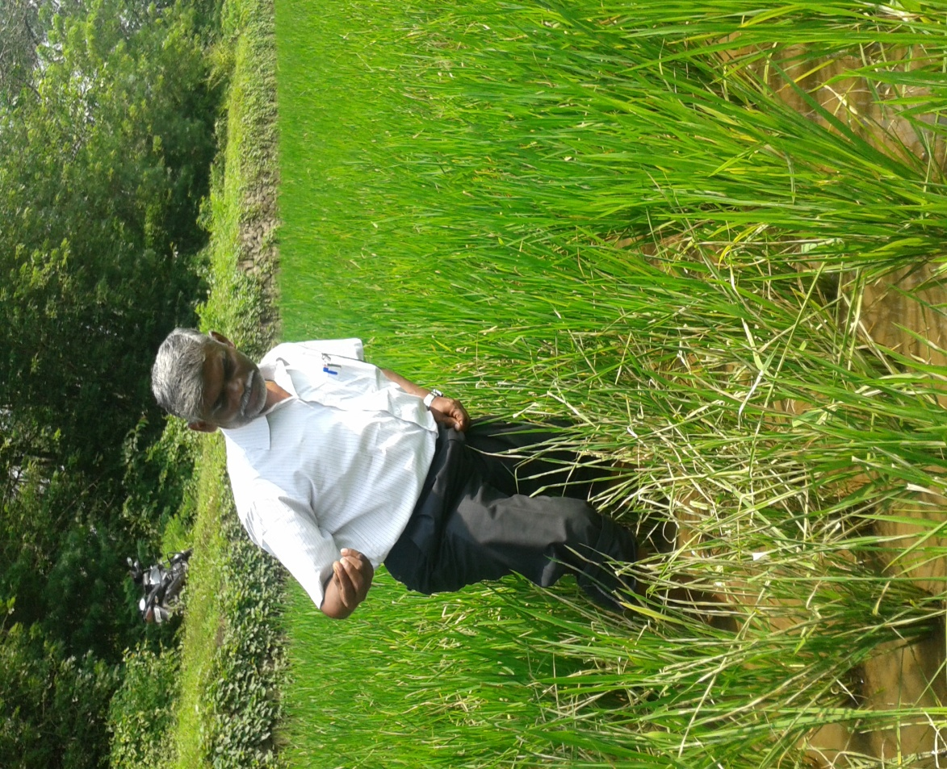
LEAF ROLLER ATTACK IN PADDY

Slide 14
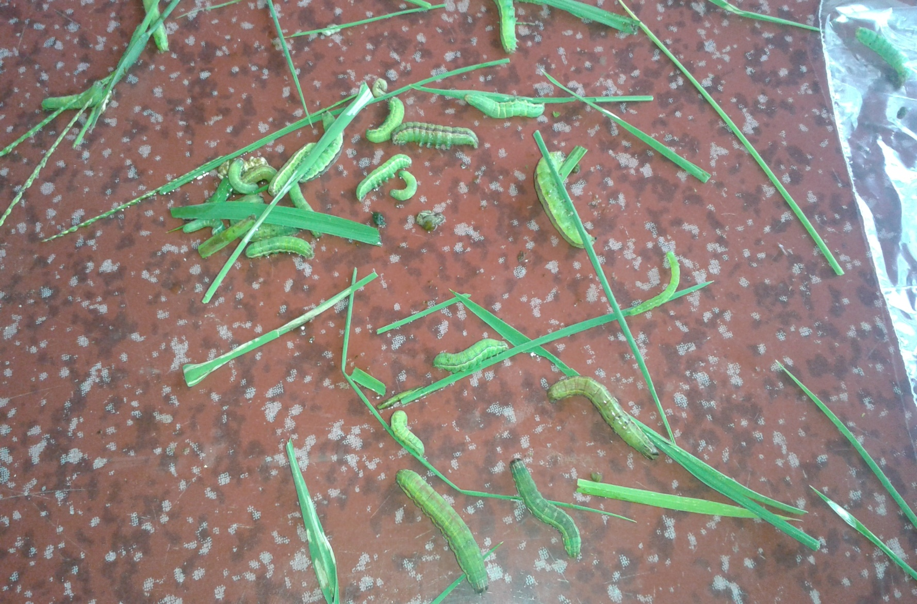
SKIPPER ATTACK IN PADDY
Pelopida Mathias: Rice Skipper

Slide 15
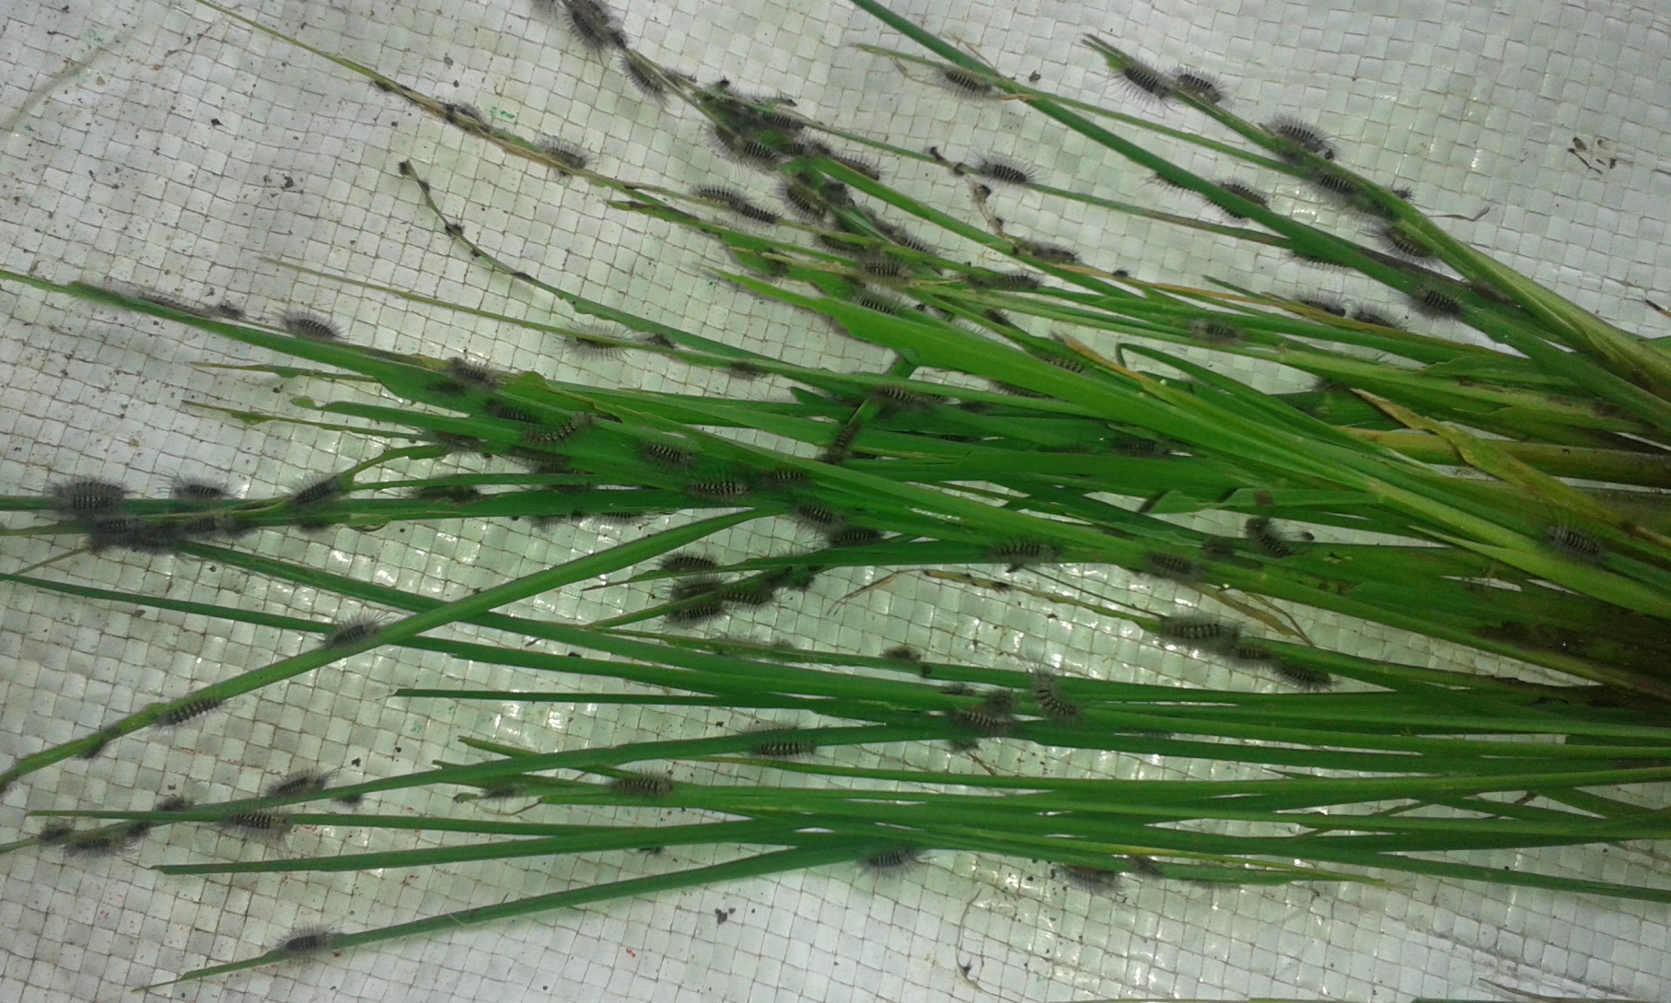
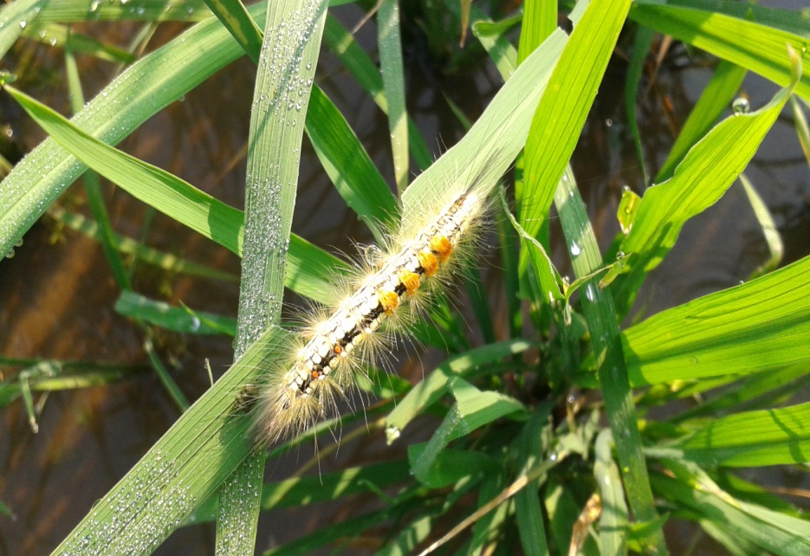
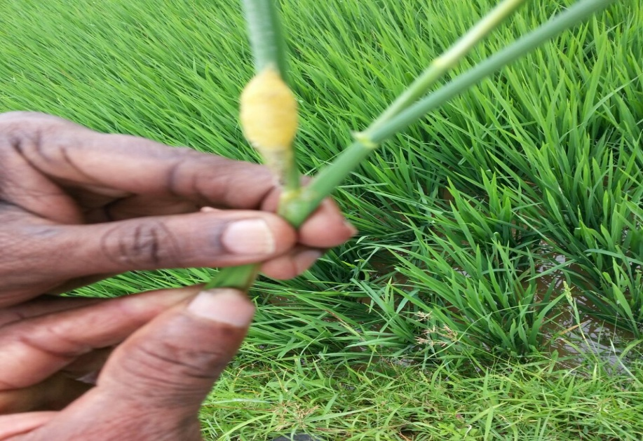
HAIRY CATERPILLAR IN PADDY
Hairy caterpillar: Psalis pennatula

Slide 16
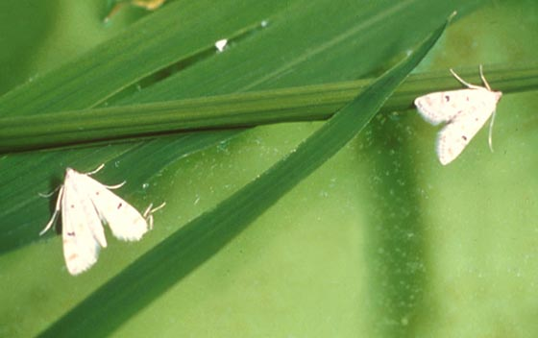



CASE WORM
Total life cycle: 5 weeks
Egg laying capacity – 165 nos.

Slide 17






BROWN PLANT HOPPER
Total life cycle: 3 weeks
Egg laying capacity – 390 nos.

Slide 18



RICE GALL MIDGE
Total life cycle: 3 weeks
Egg laying capacity – 200 nos.

Slide 19



BLUE BEETLE IN PADDY

Slide 20



RICE BUG
Total life cycle: 3 weeks
Egg laying capacity – 20 nos.

Slide 21
PADDY ECOSYSTEM
1st 20 days – More neutrals and natural enemies than pests of paddy
20 days to 45 days – More natural enemies than pests of paddy
45 days to 75 days – more pests than natural enemies
75 days to 90 days – less pests and less natural enemies

Slide 22
PADDY ECOSYSTEM
Flooded conditions – more neutrals and natural enemies which feeds on neutrals
Planting at the time of more natural enemies
More tillers and growth – more pests- which are attacked by natural enemies in egg, larval, pupal or adult stage.
Predators feeds around 15 eggs per day.
Parasitoides destroyes 50% of eggs or eggmasses
The balance will be fed by predators in larval or adult stage.

Slide 23

Pest control by spiders: Rice ecosystem
Spiders are the main biological control agents contributing to pest control across the season

Slide 24



Categories of spiders
The orb-web weaver spiders belong to Araneidae,
Tetragnathidae, and Theridosomatidae families
They feed on Hemiptera (leafhoppers), Diptera and
Orthoptera (grasshoppers)

Slide 25



Categories of spiders
The sheet-web weaver spiders belong to Linyphiidae,
Dictynidae and Theriididae
They feed on Hemiptera (aphids and leafhoppers), Diptera,
and Coleoptera (weevils)

Slide 26



Categories of spiders
The funnel-web weaver spiders belong to Agelenidae, Atypidae, Ctenezidae and Eresidae
They feed on Orthoptera, Coleoptera and Lepidoptera

Slide 27



Categories of spiders
The hunting spiders belong to Lycosidae, Oxyopidae,
Thomisidae and Salticidae
They feed on Orthoptera, Thysanoptera, Coleoptera,
Hemiptera, Lepidoptera, Diptera and Hymenoptera

Slide 28

Lycosa pseudoannulata Araneae:Lycossidae
Notes:
Wolf spider.Scamber acoss water surface when disturbed.

Slide 29

Lycosa pseudoannulata

Slide 30


Lynx Spider- Oxyopus sp

Slide 31
Oxyopes lineatipes

Slide 32


Drawf spider.Atypena formosana

Slide 33
Argiope catenulata

Slide 34
Tetragnatha maxillosa

Slide 37
Micraspis crocea- Lady Bird Beetle
Micraspis sp. brightly colored in shades of red. Lady beetles are active during the day in the upper half of the rice
canopy in dryland and wetland habitats. Both the adult and the dark larva of Micraspis crocea
feed on small planthopper prey as well as on small larvae
and exposed eggs.

Slide 38
M.crocea- Dark Larvae

Slide 39

Harmonia octomacula

Slide 40

Harmonia octomaculata larva feeding on a plant hopper nymph

Slide 41

Menochilus sexmaculatus

Slide 42
Harmonia octomaculata and Menochilus sexmaculatus are black-spotted lady beetles that catch slow-moving prey. Adults are quick to fall off plants or fly when disturbed. A lady beetle takes 1-2 weeks to develop from egg to adult and produces 150-200 offspring in 6-10 weeks. Lady beetle larvae are more voracious than adults and consume 5-10 prey (eggs,nymphs, larvae, adults) daily.

Slide 43
Ophionea nigrofasciata
Ophionea nigrofasciata can be found within the folded
leaf chambers made by leaffolder larvae. The predator
larva pupates in the soil of wetland rice bunds or dryland
fields. Each voracious predator consumes 3-5 larvae per day, leaving only the head capsules. The adult also preys on planthoppers.

Slide 44

Microvelia douglasi atrolineata Bergroth.Velidae
Adults congregate to feed on planthopper nymphs
which frequently fall onto the water. The nymph also feeds on hopper nymphs as well as on other small, soft-bodied insects. Microvelia is a more successful
predator when attacking in groups and young hopper
nymphs are more readily subdued than older and larger
prey. Each Microvelia can prey on 4-7 hoppers per day.

Slide 45
Mesovelia vittigera (Horvath) Mesovelidae
Mesovelia adults
and nymphs feed mainly on stem borer larvae and hoppers that fall on the water surface. They are solitary Feeders.

Slide 46

Water Striders Limnogonus fossarum
Limnogonus live for 1-1.5 months and lay 10-30 eggs in rice stem above the water line.
Adults and nymphs prey on rice hoppers, moths, and larvae that drop onto water surface. Each water strider takes 5-10 prey daily.

Slide 47

Cyrtorhinus lividipennis Reuter Miridae
Cyrtorhinus is an example of a species belonging to a
plant-feeding group that secondarily became predators, preferring planthopper and leafhopper eggs and young nymphs. The green and black adults and nymphs can become highly abundant in hopper-infested
fields, both wetland and dryland. Cyrtorhinus eggs are laid in plant tissue, develop to adults in 2-3 weeks, and produce 10-20 young. They search leaf sheaths and
stems for hopper eggs, which are sucked dry by piercing mouthparts. Each predator consumes 7-10 eggs or 1-5 hoppers a day.

Slide 48

Polytoxus fuscovittatus(Stal) Reduviidae
Assassin bugs as solitary predators rarely become abundant in either the wetlands or drylands. Assassin bugs occur in the rice canopy in search of prey, mainly larvae of moths and butterflies. They attack a prey even much larger than themselves, piercing its body with their needle-like mouthparts to inject a paralyzing toxin.

Slide 49
Agriocnemes pygmoea
The male hooks onto the
back of the female so they can fly while mating to escape their enemies. Damselfly nymphs are aquatic and can
climb up rice stems to search for hopper nymphs. Adults normally fly below the rice canopy searching for flying insects as well as hoppers on plants.
Notes:
Male

Slide 50
A.Femina femina
Notes:
Mating pair

Slide 51

Crickets- Metioche vittaticollis
Adults and nymphs are
primarily egg predators but will also feed on small larvae
and hoppers. They feed on eggs of striped and dark headed stem borers, leaffolders, armyworms, whorl
maggots, and nymphs of planthoppers and leafhoppers

Slide 52

Predator Grass Hopper Conocephalus longipennis
Tettigoniids feed on rice foliage and Conocephalus
longipennis has dual food habits. Aside from feeding on
rice leaves and panicles, Conocephalus is also a predator
of rice bug and stem borer eggs as well as planthopper
and leafhopper nymphs. Each predator can consume 3-
4 yellow stem borer egg masses a day.

Slide 53

Predator — earwig Euborellia stali
Adults live 3-5 months and are most active at night. Earwigs enter stem borer tunnels in search of larvae. Occasionally they climb the foliage to prey on leaffolder larvae. They can consume 20-30 prey daily.

Slide 54

Green Lace Wing Chrysoperla sp

Slide 55

Egg parasite of Stem Borer
Trichogramma japonicum

Slide 56

Trichogramma chilonis
Eggparasite of leaf folder

Slide 57


Egg card
Trichogramma chilonis for leaf folder
Trichogramma japonicum for Stem borer

Slide 58





Slide 59
Tetrastichus schoenobii Eulophidae

Slide 61

Telenomus rowani(Gahan) Scelionidae
Tetrastichus and Telenomus may parazitize the same egg mass but
Not the same egg

Slide 62

Gontocerus spp.Mymaridae
Female can reproduce without mating.Parasitise the eggs of leaf hoppers and plant hoppers.

Slide 63

Anagrus optabilis(Perekins) Mymaridae
Female can reproduce without mating.Egg parasite of leaf hoppers and plant hoppers.Parasitized eggs turn deep orange red and nomal eggs are white.

Slide 64

Barely visible to the naked eye. Parasite larva develop inside host larva even after host larva hatch. The wasp egg divide many times and hundreds of wasp pupae can be seen through skin of LR larva.
Copidosomopsis nacoleiae
Encyrtidae

Slide 65

Amauromorpha accepta Ichneumonidae. Specialises in yellow and white stem borers.Single egg is laid in larval host.Emerges from dead host and pupates in larval tunnel.

Slide 66

Itoplectis narangae
Parasitises larvae of leaf folder,green semilooper,hairy caterpillar and striped and pink stem borers.

Slide 67

Trichomma cnaphalocrosis Ichneumonidae
Older leaf folder larvae preferred.Lays single egg in leaf folder larva encountered. Pupates with in its host.

Slide 68

charops brachypterum
Ichneumonidae.Searches larvae of leaf folders,green semiloopers and yellow stem borers.

Slide 70


Larval parasitiodes in Paddy Charops Brachypterum

Slide 71
Xanthopimpla flavolineata
Ichneumonidae.Parasitise stemborer larva one wasp emerges from stemborer pupa with in the stem.

Slide 72

Stenobracon nicevillei(Bingham) Braconidae
Common in drylands .Seach for larva of yellow and Pink stem borer.Deposit single egg in to STB larva.

Slide 73

Temelucha philippinensis Hymenoptera: lchneumonidae
Temelucha is medium-sized and is a fast flier. During the day, they hunt stem borer or leaffolder larval hosts. When stem borer larvae move from one tiller to another they are parasitized before they can rebore into the rice stem. Upon maturity, the parasite larva leaves its host and spins a light brown cocoon in the stem borer tunnel or folded leaf. The adult wasps live 7-9 days.

Slide 74

Cardiochiles philippinensis Braconidae.
Lays single egg on leaf folder larva.The creamy white wasp larva feeds externally on host larva

Slide 75

Macrocentrus philippinensis Braconidae
Single egg is laid in a leaf folder larva.Spins a white cocoon with in leaf fold.

Slide 76

Cotesia angustibasis.Braconidae

Slide 77


Parasitoids identified during surveillance in paddy
Larval parasitiod Cotesia attacking on leaf folder larva

Slide 79
C.Angustibasis specialises as larval parasite of LF .

Slide 80

Opius sp. Braconidae.
Parasitse whorl maggot larva.One parasite larva develops in each larval host.Wasp emerges from whorl maggot pupa.

Slide 81

Goniozus nr. Triangulifer Keiffer. Bethylidae
Ant-like wasps.Parasite enters folded leaf and paralizes leaf folder larva and then lays 3to 8 eggs outside host larval body,

Slide 82

Elasmus sp. Elasmidae.
Parasitises leaf folder larva. Adult emerges either from the larva or pupa. Elasmus larva will kill other parasite larva developing inside the host larva.

Slide 83

Haplogonatopus apicalis.Pseudogonatopus nudus.
Haplogonatopus attack leaf hoppers and pseudogonatopus plant hoppers.

Slide 84

Pseudogonatopus flavifemur. Dryinidae.
One to two eggs are laid singly inside the
hopper host. In 1-2 days, the eggs hatch and the larvae feed on the body fluids. As they grow, the parasite larvae, each covered with a black to grayish sac, protrude from the abdomen of their hosts . In 7-1 0 days, the sac splits and the whitish larva wiggles free.
The larva then pupates and secretes a whitish oval silk cocoon to cover the pupa on the plant . The flat cocoon turns reddish brown when the wasp is ready to emerge.

Slide 85

Brachymeria sp
The parasitize older larvae of leaffolders, skippers, and satyrids. A single egg is deposited in the body of each larval or pupal host and pupation occurs inside the host. Adult wasps emerge from the head portion of the pupa and live 3-5 days.

Slide 86

Argyrophylax nigrotibialis Tachinidae
Parasitises the skipper larva. The puparia near the dead skipper larva are covered with white powder.

Slide 87

Pipunculus/Tornosveriella sp
Big-headed flies alight on the back of leafhoppers
and oviposit into the host’s abdomen. A single fly
develops from each leafhopper. After developing inside its host, it pupates in the soil or at the base of the
plant. The egg develops into an adult in 30-40 days.
Flies live 4 days and parasitize 2-3 hoppers per day.

Slide 88

Metarhizium.Moniliales:Moniliaceae
Fungi infect hoppers,bugs and beetles.Spores germinate to grow in to insect body,consume body contents.When the insect dies the fungus emerges first as white growth from the host bodyjoints.When spores are formed the fungus turns dark green if it isM.anisopliae or light green if it is M.flavoviridae.Spores emerging from dead host are spread to new hosts by wind and water.

Slide 89
M.anisopliae

Slide 90
M.flavoviridae

Slide 91

Beauveria bassiana.Moniliales:Moniliaceae
White fungus attacks plant hoppers,leaf hoppers,stem borers,leaf folders,rice bugs and black bugs.Invades soft tissues and body fluids and grows out of the body to produce dispersing spores.Spores appear chalky white as on fhe body of BPH.

Slide 92
B.bassiana
Chalky white spores

Slide 93

Hirsutella citriformis.Moniliales:Stilbaceae
Infects plant hoppers and leaf hoppers.The fungus grows out of the body of the host as long filaments.The dispersing infectious spores are produced from the filaments.

Slide 95

Nomuraea releyi.Moniliaceae
Attacks larvae of stem borers,leaf folders,green hairy caterpillars,armyworms and caseworms.Early in the infective stages the larvae become white.After few days spores are formed and the caterpillars become pale green

Slide 96

Nuclear polyhedrosis viruses.Baculovirus:Baculoviridae
The cut worm becomes infected by eating virus contaminated foliage.Host larva becomes sluggish and stops feeding..Larva turns whitish and then black and hangs from the rice foliage by its prolegs.oozing fluid contaminates nearby foliage and continues disease cycle.

Slide 97
Granulosus virus.Baculovirus:Baculoviridae
Viruses attack moth and butterfly larvae.Host larva eats contaminated foliage slows movement and stops feeding.After 1to2 weeks the body becomes constricted giving segmented appearance as in the larva of semilooper.Infected larvae turn yellow,pink and black.

Slide 98



Lycosa pseudoannulata
Damsel flies
Elasmus sp
Argiope spider

Slide 99




Red eyed predatory flies
Dragon fly eggs
Phidippus spider
Tetragnatha spider

Slide 100




Spider Egg mass
Lady Bird Beetle
Cotesia pupal case
Lycosa spider

Slide 101




Micraspis sp
Elasmus sp
Tetragnatha spider
Phidippus spider

Slide 102


Brachymeria emerged from Pupal case of Psalis pennatula

Slide 103




Elasmus sp
Stenobracon nicevillei
Ophionea nigrofaciata

Slide 104




SPIDERS OF RICE ECOSYSTEM

Slide 105




PARASITIODES IN RICE ECOSYSTEM

Slide 106




Ophionea nigrofaciata
Xanthopimpla sp

Slide 107





Slide 108


PROMOTION OF BIO CONTROL AGENTS

Slide 109


Monitoring Trap for YSB in paddy

Slide 110


Ecological engineering in Paddy

Slide 111


Slide 112
AGRO ECOSYSTEM ANALYSIS
Importance of P:D Ratio
DEFENDERS PESTS
Dragon fly-2 Stemborer- 3
Ophionea- 3 Leaf folder- 4
Spides- 10 Blue beetle- 2
Cyrtorhinus -15 BPH- 6
Total- 30 Total- 15
P: D Ratio- 15/30= 1: 2
(Favourable P: D Ratio: 2:1)

Slide 113

Predator gets an opportunity to develop well in advance of normal pest population
Treated and un treated

Slide 114
Treated with pesticides and untreated
Untreated-Rise in neutral peak at 30 days. Subsequent rise of predator populations.Predator population build up on neutrals.pest populations have little chance to develop late in the season.
Treated-Leads to suppression of early season predator populations. subsequent resurgence of pest populations-Pesticide induced pest resurgence.

Slide 115

Trophic-level of energy flow
irrigated rice
Notes:
Irrigated rice

Slide 116

What is FFS….....?
A group of farmers meet regularly in a field at weekly intervals during a crop season. After observation of the crop dynamics, they discuss and take economical crop management decisions for that week, under the guidance of a trained facilitator(s). These informed decisions will empower farmers for adopting best agricultural practices and proactive towards adverse seasonal conditions.

Slide 117

Crop is opened work book for weekly field observations, sharing of experiences, discussions, decisions and application of appropriate interventions leads to gain new experiences by farmers.

Slide 118

Objective of FFS
Empowering the farmers to take up economical crop management decisions by adopting AESA with Ecological Engineering practices. .
Where emphasis is being given
to reduce the cost of cultivation
restoring soil fertility
enhance in productivity
decrease the chemical pesticide usage by adopting
eco- friendly alternative measures to protect the
crop .

Slide 119

FFS IN A CROP SEASON
Tillering Panicle
GROWTH STAGES
FFS OFFERS PRACTICAL TRAINING TO FARMERS IN FIELD FOR
14 TO 16 WEEKS. EACH FFS HAS 30 FARMERS
AND A FIELD AREA OF 25 ACRES

Slide 120
FFS Learning Field 2.00 acres
Integrated Pest Management Practices | Field Validation Trials | Farmers’ Practice

Slide 121


Slide 122

THANK YOU.....

